Slide 1
Presenter 1: Event Handling Architecture

Slide 2
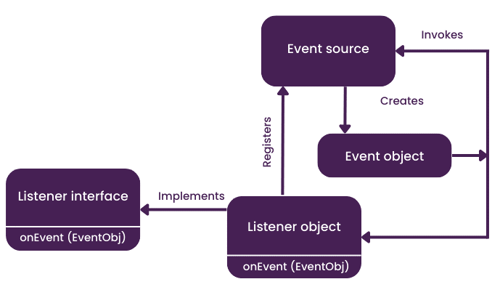
What is Event Handling?
From :Delegation Event Model in Java: A Complete Guide
Event handling is the mechanism used to respond to user actions1. It's crucial for creating interactive GUIs. When a user interacts with a component (e.g., clicks a button), an event is generated. An event source (the component) then notifies one or more event listeners.
Notes: This is the big picture. Explain the flow from user action to event.

Slide 3
The Event-Listener Model
Content:
Event Source: A GUI component (like a button) that generates an event.
Event Object: An object that encapsulates information about the event that occurred4.
Event Listener: An object that "listens" for a specific type of event and performs an action when it occurs. The listener interface defines the methods that must be implemented.
Analogy:
Think of it like a doorbell. The button is the event source, the sound is the event, and you are the listener waiting to open the door.

Slide 4
The Event Dispatch Thread
Content:
All event-handling code runs on a single thread called the Event Dispatch Thread (EDT).
This ensures thread safety and prevents race conditions when updating the GUI.
Crucial Rule: Never perform long-running tasks on the EDT, as this will block the GUI, making it unresponsive.
// Example: long task that should NOT run on the EDT public void actionPerformed(ActionEvent e) { // This will freeze the GUI! try { Thread.sleep(5000); } catch (InterruptedException ex) {} }

Slide 5
Listener Interfaces & Adapter Classes
Listener interfaces (e.g.,MouseListener) often have multiple methods⁹. You must implement all of them, even if you only need one.
Adapter Classes provide a convenience by giving an empty implementation for all methods¹⁰. You can extend an adapter and override only the methods you need.
// Using a MouseAdapter instead of MouseListener myComponent.addMouseListener(new MouseAdapter() { @Override public void mouseClicked(MouseEvent e) { System.out.println("Mouse clicked!"); }
});

Slide 6
Presenter 2: Handling Button Clicks with ActionListener

Slide 7
Handling Button Clicks with ActionListener
Content:
The ActionListener is the most common listener, used for responding to high-level semantic events like a button click or pressing Enter in a text field.
It has only one method to implement: actionPerformed(ActionEvent e).
The ActionEvent object contains information about the event, such as the event source.
Analogy: The ActionListener is the "I'm ready to do something!" command.

Slide 8
Example: A Simple Button Click
import javax.swing.*; import java.awt.event.*; public class MyButtonApp { public static void main(String[] args) { JFrame frame = new JFrame("Click Me!"); JButton button = new JButton("Click Me"); button.addActionListener(new ActionListener() { @Override public void actionPerformed(ActionEvent e) { JOptionPane.showMessageDialog(frame, "Button was clicked!"); } }); frame.add(button); frame.pack(); frame.setVisible(true); } }
First, create a component (e.g., JButton).
Then, create a class that implements ActionListener.
Finally, add the listener to the button using addActionListener().

Slide 9
The ActionEvent
The ActionEvent object is passed to the actionPerformed() method.
Key methods:
e.getSource(): Returns the object that gengetActionCommanderated the event.
e. (): Gets the command string associated with the action (e.g., the button's text).
JButton saveBtn = new JButton("Save"); saveBtn.addActionListener(e -> { if (e.getActionCommand().equals("Save")) { System.out.println("The Save button was clicked."); } });

Slide 10
Best Practices for Handling Actions
Content:
Use Inner Classes: For simple listeners, anonymous inner classes or lambda expressions are concise.
Separate Logic: For complex applications, move event-handling logic into separate methods or classes to keep your code clean and organized.
Command Pattern: Consider using the command pattern for reusable actions across different components (e.g., a "Save" action that works for a menu item, a toolbar button, and a keyboard shortcut).
Notes: Reiterate that the code should be readable and maintainable. This also sets up the next presenter's topic.

Slide 11
Presenter 3: Mouse and Keyboard Events

Slide 12
Responding to Mouse Clicks
Content:
The MouseListener interface handles specific mouse events like a button press, release, or click.
It has five methods: mouseClicked, mousePressed, mouseReleased, mouseEntered, and mouseExited. You must implement all of them.
The MouseEvent object provides details about the mouse event, such as coordinates (getX(), getY()) and the number of clicks.
Analogy: Imagine a mouse trap. It waits for one of five different actions (entered, exited, clicked, pressed, released) before it "springs."

Slide 13
Practical Example with MouseAdapter
Instead of implementing all MouseListener methods, we can extend the MouseAdapter abstract class and override only the ones we need.
JPanel panel = new JPanel(); panel.addMouseListener(new MouseAdapter() { @Override public void mouseClicked(MouseEvent e) { System.out.println("Mouse clicked at X: " + e.getX() + ", Y: " + e.getY()); } });

Slide 14
Handling Keyboard Input
Content:
The KeyListener interface is used to handle keyboard events.
It has three methods: keyPressed, keyReleased, and keyTyped.
Important: For a component to receive keyboard events, it must have focus.
The KeyEvent object provides information about the key that was pressed.
Notes: Explain the difference between the three methods (keyPressed for holding down a key, keyTyped for a character input).

Slide 15
KeyListener Example
JTextField textField = new JTextField(20); textField.addKeyListener(new KeyAdapter() { @Override public void keyTyped(KeyEvent e) { char keyChar = e.getKeyChar(); System.out.println("You typed: " + keyChar); } });
Attach the KeyListener to a component that can gain focus (e.g., a JTextField).

Slide 16
Presenter 4: Advanced Listeners and Best Practices

Slide 17
The FocusListener
JTextField emailField = new JTextField(20); emailField.addFocusListener(new FocusAdapter() { @Override public void focusGained(FocusEvent e) { emailField.setBackground(Color.YELLOW); } @Override public void focusLost(FocusEvent e) { emailField.setBackground(Color.WHITE); } });
A FocusListener is used to detect when a component gains or loses keyboard focus.
It has two methods: focusGained(FocusEvent e) and focusLost(FocusEvent e).
This is useful for providing visual feedback (e.g., highlighting a text field when the user clicks on it).

Slide 18
The WindowListener
The WindowListener is used to handle events related to a window (e.g., closing, minimizing, or maximizing).
It has seven methods, but the most common is windowClosing(), used to confirm an exit with the user.
JFrame frame = new JFrame("Window Listener"); frame.addWindowListener(new WindowAdapter() { @Override public void windowClosing(WindowEvent e) { int result = JOptionPane.showConfirmDialog(frame, "Sure to exit?"); if (result == JOptionPane.YES_OPTION) { frame.setDefaultCloseOperation(JFrame.DISPOSE_ON_CLOSE); } } });

Slide 19
Best Practices: Avoiding a Frozen GUI
Content:
The EDT is Sacred: Do not run long-running tasks on the Event Dispatch Thread (EDT).
Use SwingWorker: For long tasks like file I/O or network calls, use the SwingWorker class. It allows you to run a task in a background thread and then safely update the GUI when it's done.
Adapters for Simplicity: Use adapter classes to write cleaner code and avoid implementing unused methods.

Slide 20
Debugging Tips
Use System.out.println(): A simple but effective way to track event flow. Print messages within your listener methods to see if they are being triggered.
The Debug Class: You can create a simple Debug class that prints messages with timestamps to better understand the order of events.
Debugging Tools: Use your IDE's debugger to step through your event-handling code and inspect the state of your application at each step.

